Slide 1
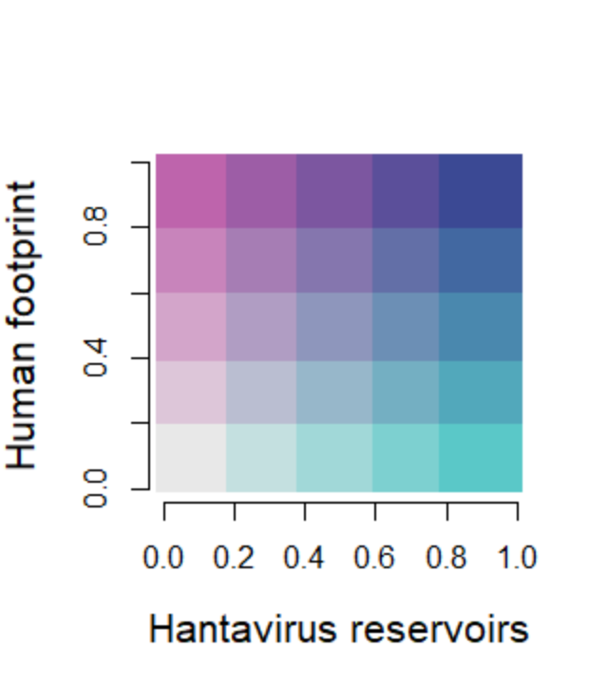
(A)
(B)

Slide 2
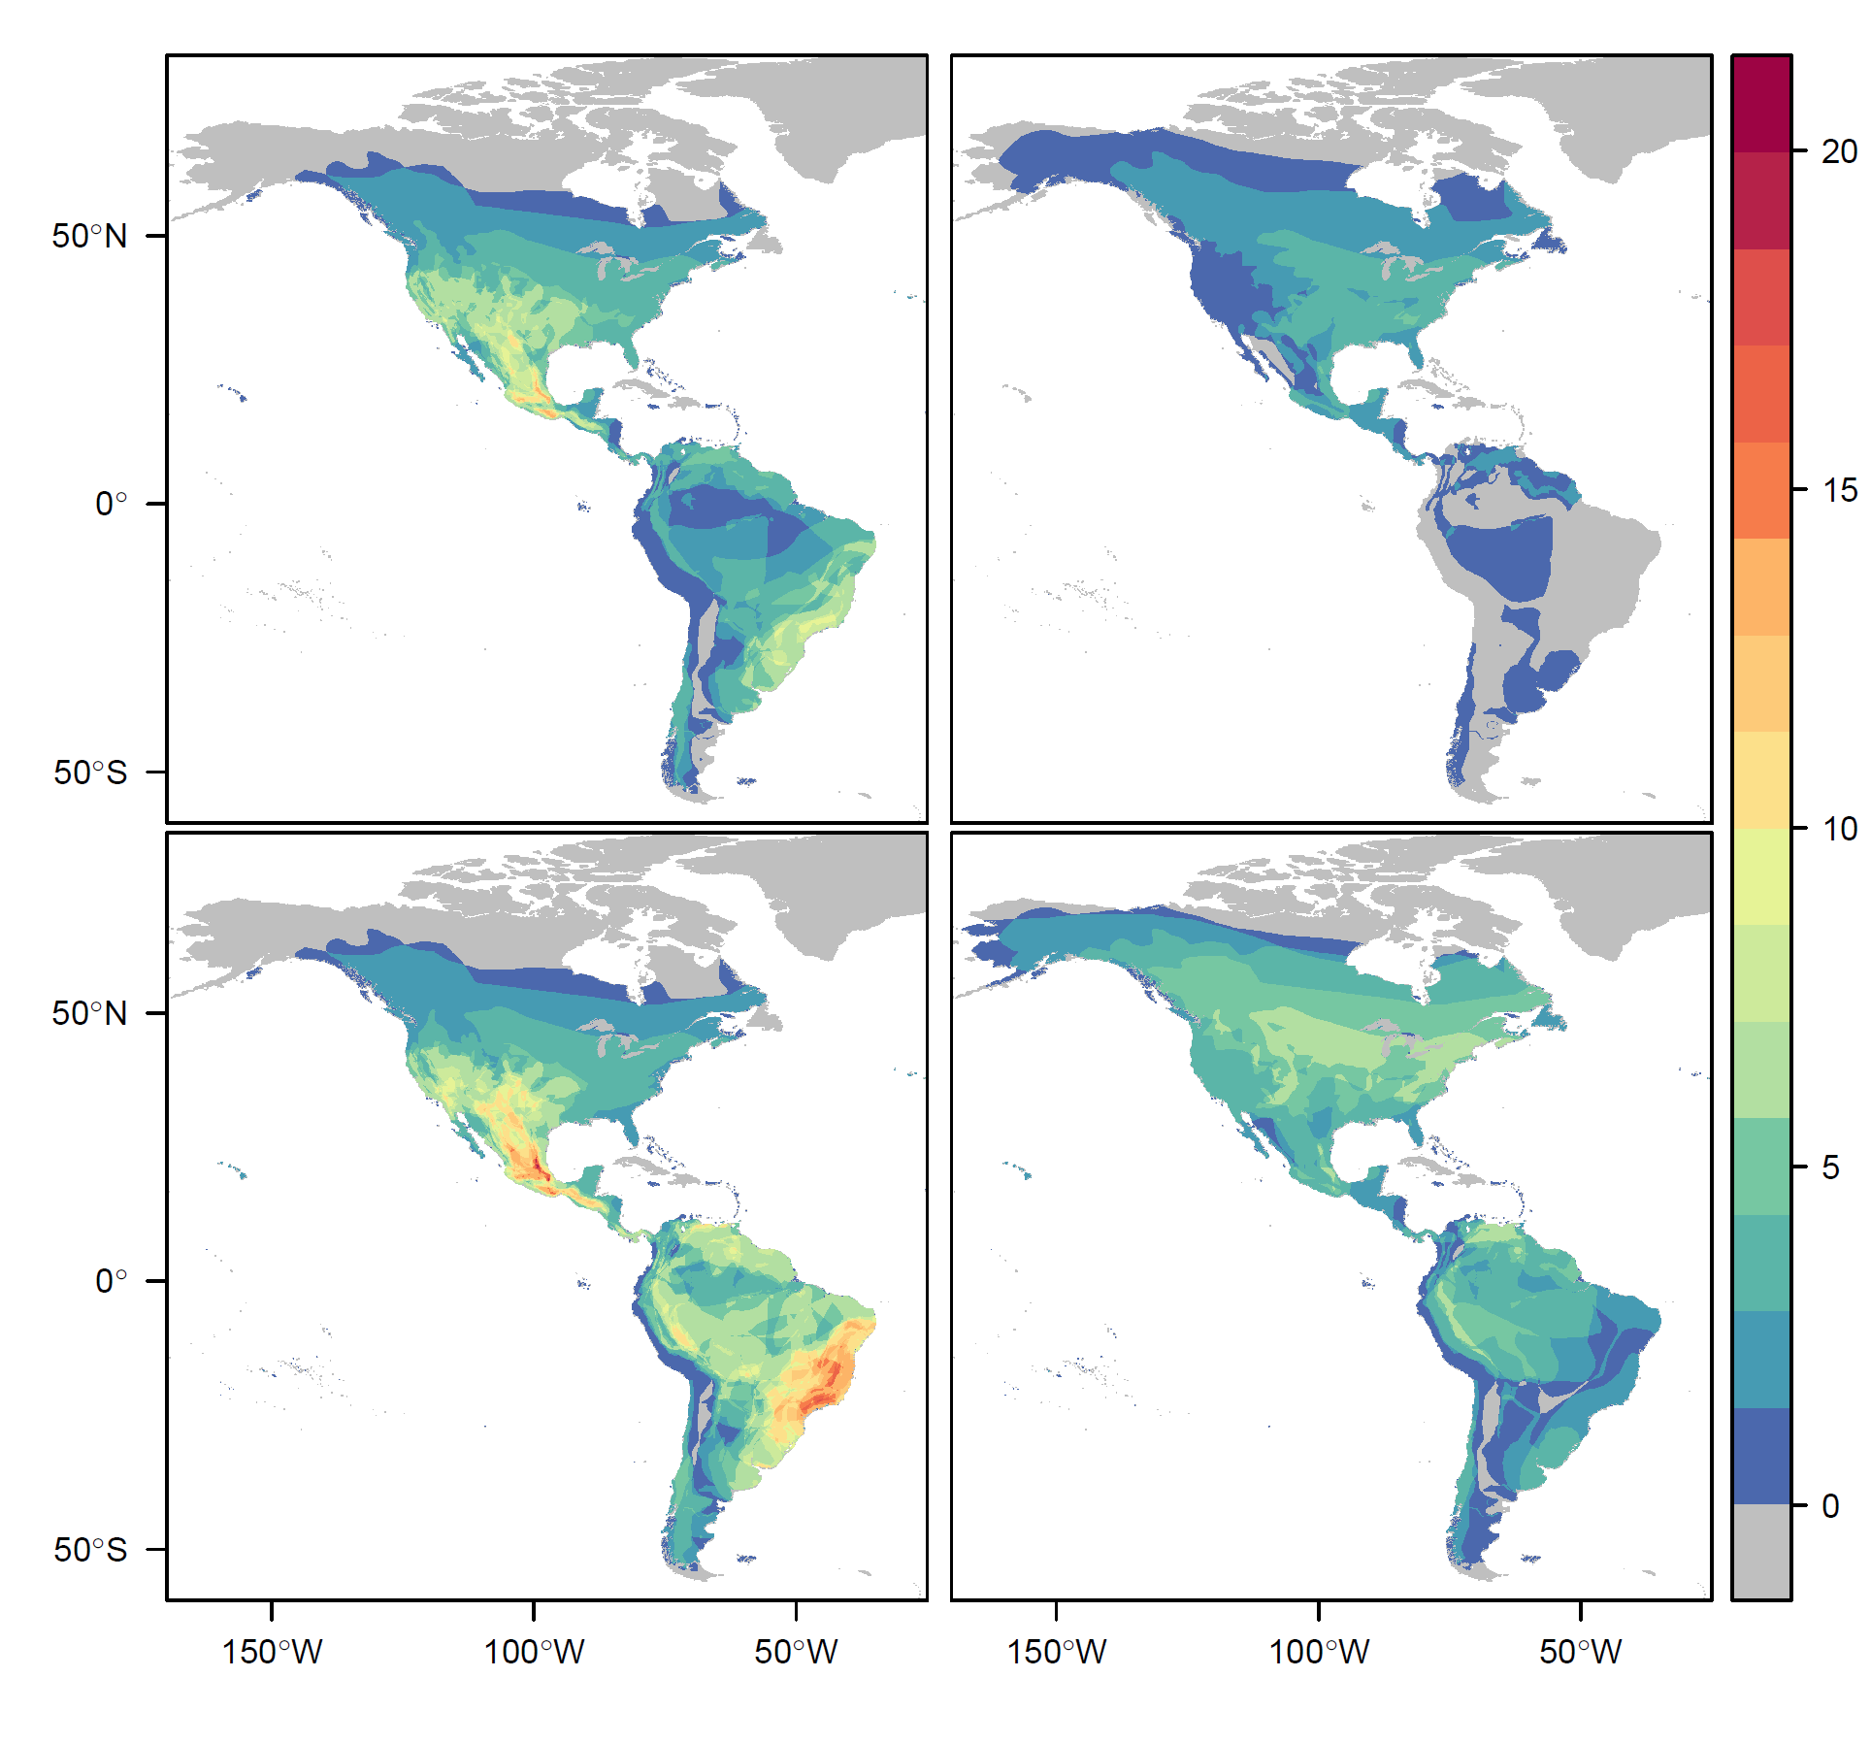
(A) (B)
n = 56 n = 12
(C) (D)
n = 113 n = 26

